Slide 1
Title :- Setup Your Printer – Drivers for Windows, iOS PC
Description :- Setting up printer is easy like 1, 2, and 3. Unbox and Setup your Printer; Connect to Wireless Network; Install Easy Setup to setup your Printer on any device.

Slide 2

Easy Setup
Home Products About Contact us
Complete Printer Setup using Easy Setup H-1
1 <strong>Unbox and Setup your Printer</strong>
2 <strong>Connect to Wireless Network</strong>
3 <strong>Install Easy Setup to connect your PC</strong>
Easy Setup will help you setup your printer, connect the printer to Wi-Fi, install print drivers on windows/iOS PC. Click Get Started to setup and install your.
Get Started

Slide 3
Main features of Easy Setup for Printers– H2
In-built automated tool with Artificial intelligence to diagnose and fix common problems with your Printers which are listed below
<strong>Resolving Print jobs stuck in queue and other printing problems </strong> : Diagnose & fix common problems with your Printers or error messages using in-built utility.
Resolving Print quality issues: If the quality of a printed document or Image is not as expected from your printers. Run in built utility to clean ink, printhead and smudges to fix print quality issues.
<strong>Resolving Printer Offline</strong> : If you see an offline message as the status for the printer or a Printer not responding message when attempting to print. Run in built utility to fix common connectivity issues with printer.
<strong>Resolving Printer not responding</strong>: If you see Printer not responding message when attempting to print. Run in built utility to diagnose and fix common connectivity issues.
Fix common scanning problems
Diagnose & fix any of the following scanning problems or error messages with your printers using in-built utility.
An error occurred communicating with the scanning device
An error occurred while communicating with the scanning/imaging device
Computer not found
No Computer Detected
Scan to computer is currently unavailable
Scan to computer no longer activated
Scan Unsuccessful
Scanner not found
Scanner Unreachable
The scanner could not be initialized

Slide 4
<b>why chose Easy Setup for Printer Setup</B>
Effortlessly Setup, Print, Scan, Fax
Setup your Printers on Windows or Mac PC to Print, Scan fax, your Images. and documents effortlessly
Spontaneous updates
Easy Setup for Printer drivers has set you free from updating software's manually as it comes with a unique feature of updating it automatically.
Any Brand, Any Device, Anytime
Print, Scan, Fax, Edit, or Share your Images and Documents with any device, from any brand, anytime.
Practice Safety
We ensure data protection for our users and also check that no sensitive information should be compromised.

Slide 5
System requirements for Easy Setup
Storage -You'll need at least 512 MB of free space on your hard drive to Download Printer driver and software on PC.
OS :- Your computer system must have Windows 7, Windows 8, Windows 8.1, Windows 10, 10.1, 11, or MAC Operating System to install full feature driver and software.
Other system requirements:
• 1 GB RAM • Internet connection • Internet Explorer 7+ • 266 MHz or faster computer processor • 1024 x 768 or higher screen resolution recommended

Slide 6
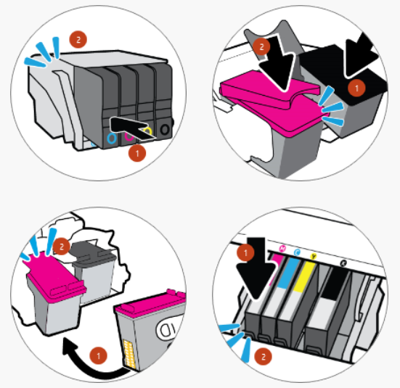
Simple Steps for Complete Printer Setup and Installation –H2 Setting up printer is easy like 1, 2, and 3. Unbox and Setup your Printer; Connect to Wireless Network; Install Easy Setup Print, Scan and Fax on any device.
1.) UNBOX AND SETUP YOUR PRINTER H-3 simple steps Unbox a printer, install cartridges, load paper. and Printer setup.
Unpack Your New Printer – H3
a.) Remove the packing materials and tape from outside the printer
b.) For All-in-one printers remove all tapes and packing material from the scanner glass
C.) Remove all tape and packing materials from inside the printer near the carriage and paper input tray.
Setup Your Printer – H3
a.) Plug your printer into a power source, turn on your printer.
b.) Set the language, time, and country/region on the printer control panel.
c.) Install the cartridges & Align the ink/cartridges for your Printer

Slide 7
2.) Connect Printer to Wireless Network H-4 Simple <strong>steps to connect Printer to a Wireless network</strong> to connect your printer to your smartphone, tablets, and PC’s from any brand any OS.
Steps to Connect Printer to Wireless network : Touchscreen/Wireless Setup Wizard H-4
Steps to install Printer on Wireless network: Non Touchscreen/WPS Setup H-4
From your printer Home screen Click on Setup Icon and Select Network Setup.
Under Network setup Click on Wireless settings and select Wireless setup Wizard from the wireless setting menu.
Your Printer will search for available wireless network and will display all the available options for wireless network.
Select the Wireless network name and enter the password for your wireless network <strong>to connect your printer to wireless network</strong>.
Once the connection is successful hit Print icon to print wireless summary of your printer
Locate the Wireless button on your Printer
Press and Hold the wireless button from your printer for 3 Sec until the light start flashes/Blinking.
Now go to your router/Modem and Locate the WPS button on it
Press and Hold the WPS button from the router for 30 Secs to connect your printer to your wireless network.
Now you can see the printer Wireless light is Solid and its connected to your wireless network.
Hit Information icon to print wireless summary of your printer.

Slide 8
Steps to download and install Printer Driver and Software using Easy Setup. H-5
1.) Click here or go to official website for Easy Setup.
2.) Click on Get started Icon
3.) Enter your Printer Serial or Model number to get started with your Printer setup.
4.) Follow on screen instructions and choose pack to get the Easy Setup link to download and install your printer on windows or apple PC.
5.) Click “Download” button to download Easy Setup installer and let your computer to open or run the installer on your PC.
6.) Easy Setup installer will detects you printer model and will redirects you to Official printer driver download page.

Slide 9
Install Printer Drivers Apple/Mac PC H-5
Once You are on Printer driver download page hit Download button to get Printer driver for your Mac/Apple PC.
Click Save File to save printer installer to download folder on of your iOS PC.
Open finder and open downloads folder of your Mac/apple PC and locate the downloaded file.
Open and Allow printer driver installer to install your printer driver and software on your Apple/Mac PC.
Install Printer Drivers on Windows PC H-5
Once You are on Printer driver download page hit Download button to get Printer driver for your windows 11, 10, 8 or older PC. Click Save File to save printer installer to download folder on of your windows PC.
Open windows explorer and open downloads folder of your windows PC and locate the downloaded file.
Open and Run printer driver installer to install your printer driver and software on your Windows PC.

Slide 10
.
6.) Locate your Printer Icon on your PC and Open to connect your Printer to Windows or Apple/Mac PC.
8.) Click Add a Printer to connect your Printer to your Windows 11, 10, 8.1, 8, 7 or Apple/Mac PC.
9.) Select the Printer which you want to connect to your PC.
10.) follow the on-screen instructions to complete the Printer Setup.
10.) Print test page to confirm your printer connection is successful.

Slide 11
Easy Setup
Home Products About Contact us
New! Printer Installer
Instantly Enable All of Your Printers
Easy Setup automatically install and update your printers drivers on Windows or iOS PC so you can get your printer working without the headaches!
Buy Now
Special Offer! H-2 Keep your Printer drivers up-to-date automatically from S7.99/month only!

Slide 12


Best Pack
Easy Setup
1 MONTH H-3
USD $7.99/MONTH
Single PC – Windows/iOS
Easy Setup
6 MONTH H-3
USD $39.99/MONTH
Single PC – Windows/iOS
Easy Setup
1 MONTH H-3
USD $99.99/MONTH
3-Single PC – Windows/iOS
Buy Now
Buy Now
Buy Now

Slide 13

Services
Disclaimer About US Follow US
Software & Drivers for HP Printers Software & Drivers for Canon Printers
Software & Drivers for Epson Printers
Software & Drivers for Brother Printers

